Slide 1


BUSINESS PRESENTATION

Slide 2
24 YEARS EXCELLENCE
India’s One of The Best Security &
Facility Management Service Provider

Slide 3

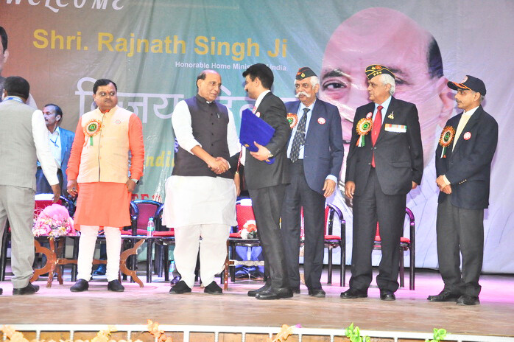


ABOUT COMPNY
Rakshak Securitas Pvt Ltd is India’s leading security and comprehensive Facility Management company, career spanning 24 years. Registered under companies Act our corporate office is at Dwarka, New Delhi, India. Manage end to end services for corporates, industries, factories, apartments Pan India.
Holding PSARA License of 18 States with a strong workforce of over 30000 and 1200 esteemed clients. By developing strategic partnerships with our clients we actively contribute towards our customers’ goals and their on going upgraded requirements

Slide 4


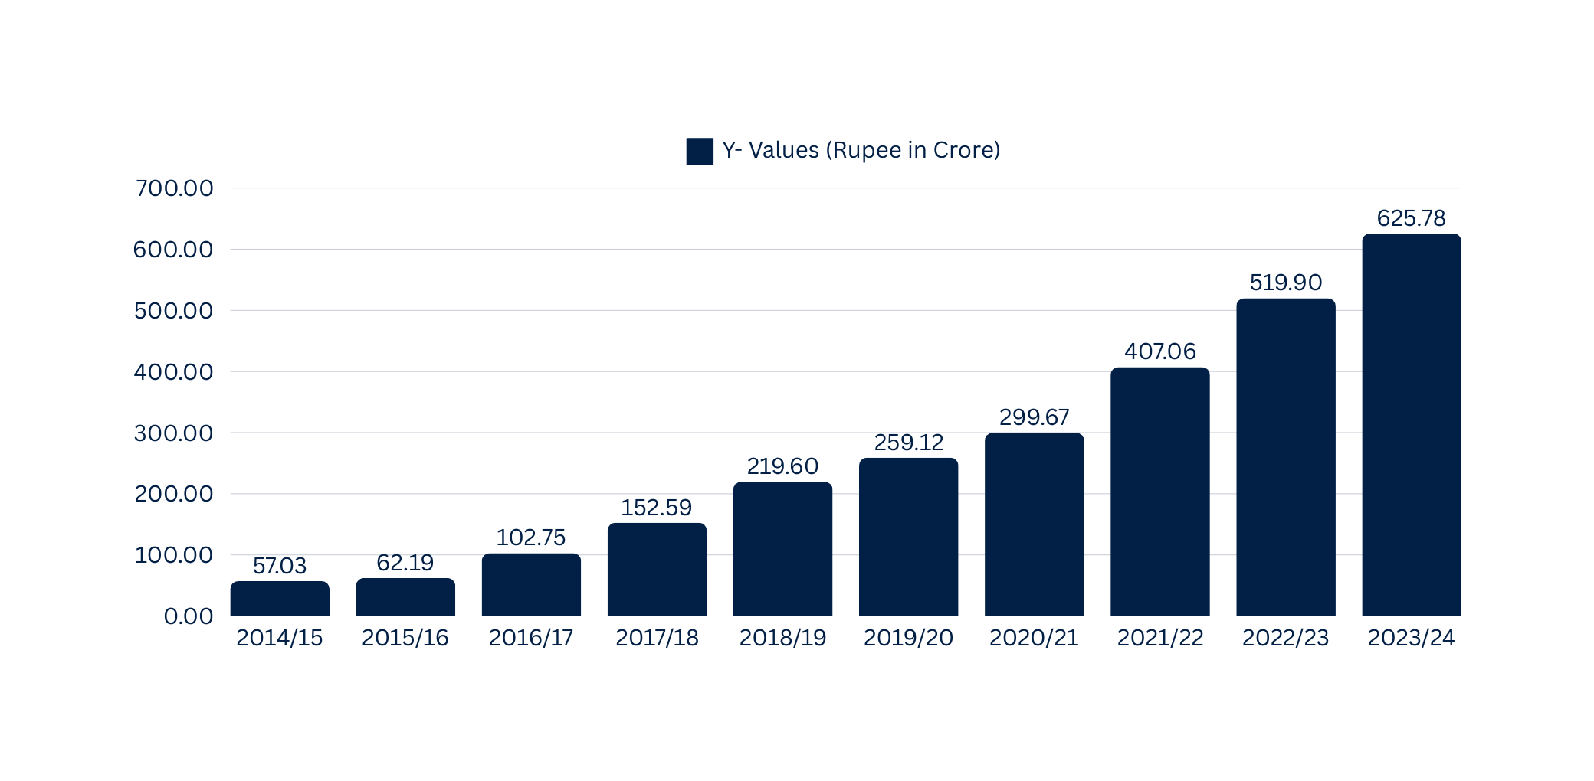
ANNUAL TURNOVER
GROWTH STORY
The economic growth story of Rakshak Securitas Pvt. Ltd. showcases its transformation from a security service provider established in 2001 to a multifaceted organization offering diverse services such as facility management, manpower solutions, and housekeeping. Over two decades, the company has built a robust presence across 18 states and union territories, serving more than 500 clients, including major corporations, government entities, and private enterprises

Slide 5
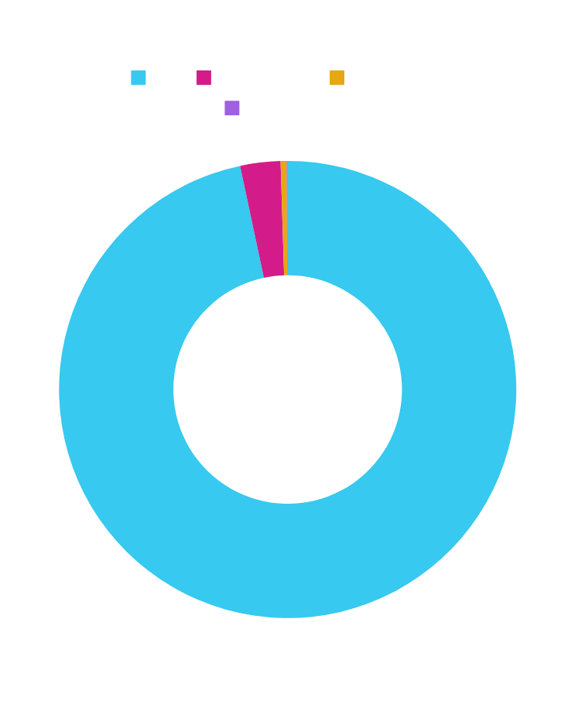
MANPOWER ON ROLL
  MANAGEMENT : 24
  MANGERIAL STAFF: 142
  SUPERVISORY STAFF : 954
  STAFF : 32436
TOTAL MANPOWER : 33556

Slide 6




RAKSHAK
SECURITAS PRIVATE LIMITED
OUR
SERVICES
  TECHNOLOGY-ENABLED SECURITY SOLUTIONS
  PROFESSIONAL SECURITY GUARDING SOLUTIONS
  RISK MANAGEMENT & CONSULTING
  COMPREHENSIVE FACILITY MANAGEMENT
  MANPOWER SERVICES
  TECHNICAL SOLUTIONS
  SKILL DEVELOPMENT & TRAINING

Slide 7



TECHNOLOGY-ENABLED SECURITY SOLUTIONS
We provide Technology-enabled Security Solutions designed to protect your assets, streamline security operations, and mitigate risks more efficiently.
Access Control Systems
E-Surveillance
CCTV Surveillance
Biometric Systems
Multi-factor Authentication
System Integration (Software & Hardware)

Slide 8


PROFESSIONAL SECURITY GUARDING SOLUTIONS
Our security professionals are recruited and carefully screened according to their talents, qualifications, experience, temperament and background.
Mobile Guarding Services
Security Marshal /Officers
PSO (Private Security Officers)
Armed and Unarmed Security Guards
Event Security Solutions

Slide 9


RISK MANAGEMENT
AND CONSULTING
We offer expert Risk Management & Consulting services to businesses across various industries. Our team of experienced professionals works closely with organizations to identify, assess, and manage risks, ensuring that they are well-prepared to handle potential threats and vulnerabilities
Risk Assessment / Analysis
Intelligence Services
Investigations
Specialized Training

Slide 10


COMPREHENSIVE
FACILITY MANAGEMENT
We specialize in providing Comprehensive Facility Management (FM) solutions that streamline operations, enhance safety, and create efficient, productive environments. Our services go beyond basic building maintenance to ensure that every aspect of your facility runs smoothly, efficiently, and sustainably. From cleaning and maintenance to security and energy management, we handle all the operational challenges, allowing you to focus on your core business.
Smart Surface Disinfection Program
Life Shield – Anti Microbial Program
UV Airborne Infection Control
Manual & Mechanized Housekeeping
Horticulture & Conservancy
Façade cleaning and ALLIED
Pest control

Slide 11


MANPOWER SERVICES
Our Manpower Services offer companies the human resources they need to drive productivity, ensure security, and manage operations with expertise and efficiency. Whether you need security personnel, facility management staff, or specialized workers for short-term or long-term engagements, we provide tailor-made solutions to meet your specific requirements.
Scientists / Engineers/ Technicians
Allied Health Professionals / Professional Hostesses
Administrative Support
Construction & Manufacturing
Skilled and Semi-Skilled Labor
Personal & Commercial Vehicle Operator

Slide 12


TECHNICAL SOLUTIONS
Technical Solutions in the context of Comprehensive Facility Management (CFM), it involves leveraging technology to streamline processes, enhance efficiency, reduce costs, and improve the overall performance of a facility.
Mechanical and Electrical – Skilled and Licensed Manpower
Management and Cost Optimization
Plumbing and Carpentry Energy
Water Treatment Systems
Building Management System (BMS)
Smart HVAC Systems

Slide 13


SKILL DEVELOPMENT & TRAINING
Skill development and training are crucial components in ensuring the success of Comprehensive Facility Management (CFM). Properly trained personnel are essential for maintaining high standards of service, reducing downtime, improving operational efficiency, and enhancing safety in the facility.
Security Training
Housekeeping Training
Skill Development Training
Fire Fighting Training
Disaster Management & Evacuation Training
First Aid Training

Slide 14


CERTIFICATIONS
  Private Security Operations Management System (ISO 18788:2015)
  Outsourcing Product Lifecycle (ISO 37500:2014)
  Social Accountability System (SA 8000:2014)
  Facility Management System (ISO 41001:2018)
  Information Security Management System (ISO/IEC 27001:2013)
  Information Security Management System (ISO/IEC 27001:2018)
  Information Security Management System (ISO 27001:2022)
  Occupational Health & Safety Management System (ISO 45001:2018)
  Quality Management System (ISO 9001:2015)
  Environmental Management System (ISO 14001:2015)
  Human Resource Management (ISO/TC 260)
  Information Technology- Service Management (ISO/IEC 20000-1:2018)
  Risk Managements (ISO 31000 :2018)
  Human Resource Management-Guidelines on recruitment (ISO 30405:202)
  Commercial Establishment of Labour License
  Regional Provided Fund Certification
  Employee State Insurance Corporation Certification
  Membership Central Association of Private Security Industry

Slide 15
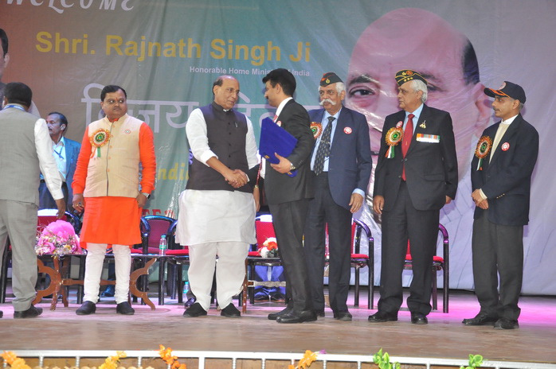

HONORS & AWARDS
PRIDE OF THE NATION
BY HOME MINISTER OF INDIA, SHRI RAJNATH SINGH
TO
MR. VINAY KUMAR SINGH
Chairman and Managing Director
RAKSHAK GROUP

Slide 16



Slide 17
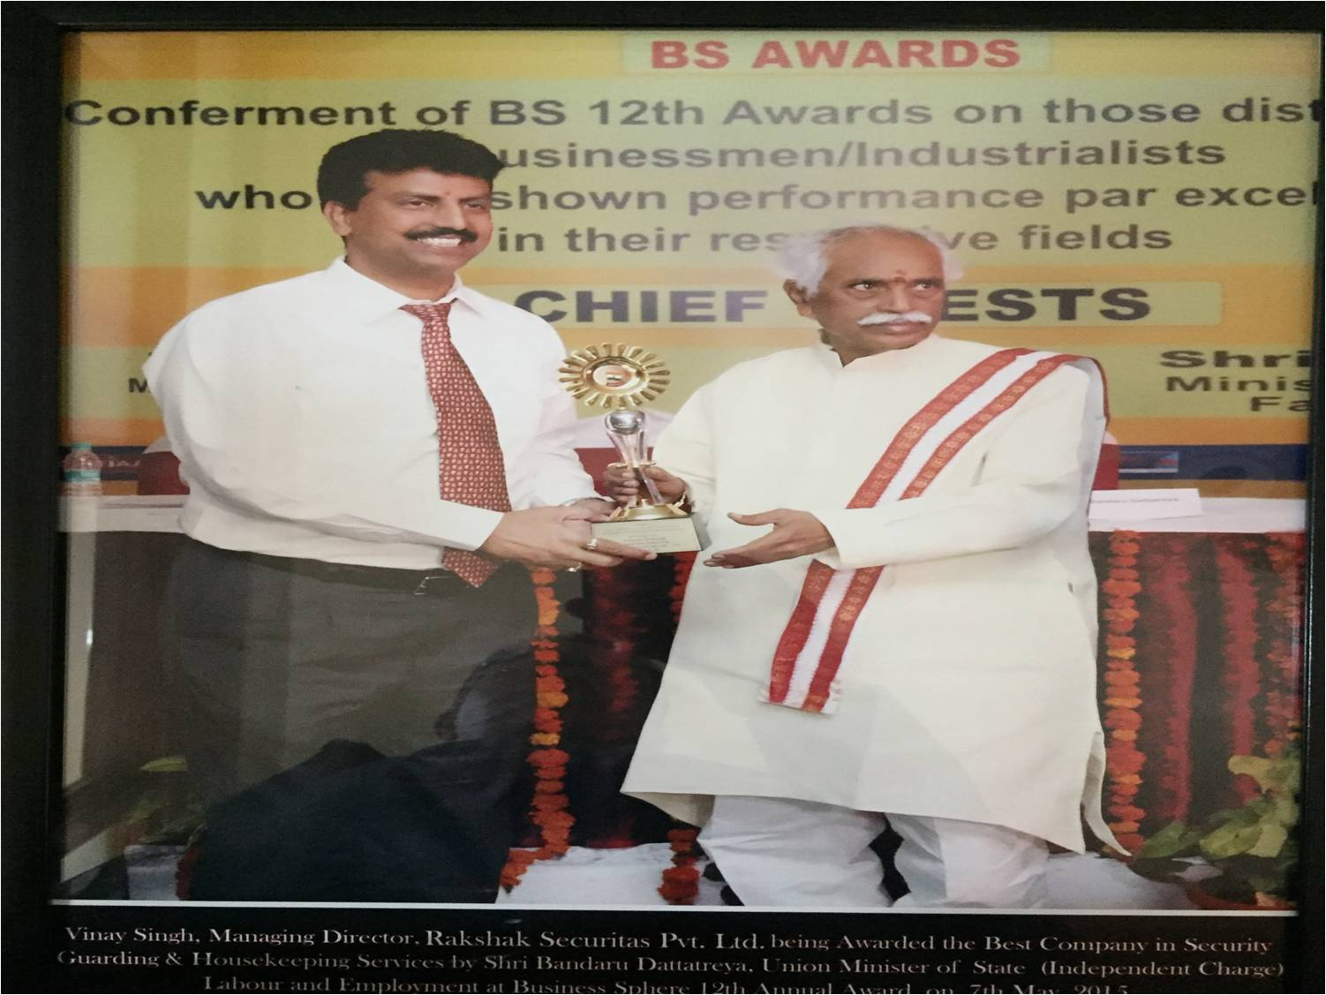
HONORS & AWARDS
BEST INDUSTRY AWARD
BY UNION STATE MINISTER OF LABOUR &
EMPOWERMENT SHRI BANDARU DATTATREYA
TO
MR. VINAY KUMAR SINGH
Chairman and Managing Director
RAKSHAK GROUP

Slide 18
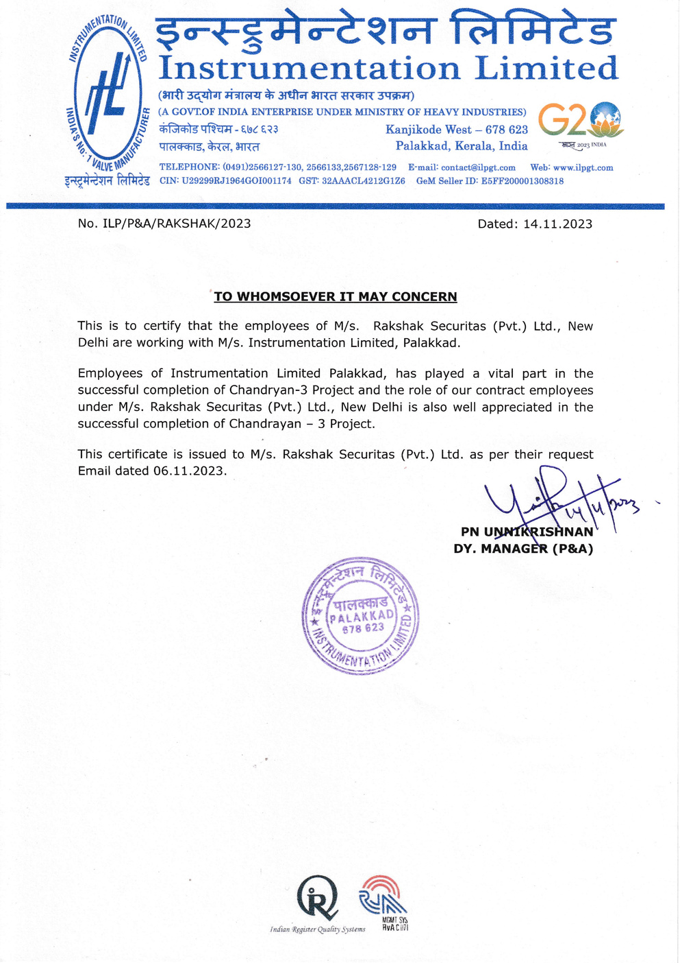
APPRECIATION LETTER
COMPLETION OF CHANDRAYAN - 3 PROJECT
Employees of Instrumentation Limited Palakkad, has played a vital part in the successful completion of Chandryan-3 Project and the role of contract employees under M/s. Rakshak Securitas Pvt Ltd, New Delhi is atso well appreciated in the successful completion of Chandrayan - 3 Project.

Slide 19

CERTIFICATE OF APPRECIATION
BEST HOUSEKEEPING SUBCONTRACTOR
Tata Project HR Head Mr Rajeev Dahiya appreciated for the Housekeeping Work of Rakshak in Tata Project Corporate office in Vadodara Gujarat.
M/s. Rakshak Securitas Pvt Ltd was awarded a Certificate of Appreciation.

Slide 20


WHY US ?
WITH RIGHT TECHNIQUES IN PLACE WE CAN AIM TO REDUCE OPERATIONAL EXPENSES REMARKABLY. WE COMPLETELY AND MINUTELY ASSESS OUR CLIENTS’ REQUIREMENTS AND OBJECTIVES AND PRESENT WHAT IS SPECIFICALLY SUITED FOR THEM
WE ARE CONSCIOUS OF THE FACT THAT OUR BUSINESS GOALS HAVE TO SUPPORT AND ENRICH THE ENVIRONMENT. WE BELIEVE EVERYTHING IS POSSIBLE
UNLIKE OTHER COMPANIES WHO BELIEVE IN SUBLETTING THEIR TASKS,WE ARE A COMPANY WHO TAKE ON THE COMPLETE WORK AND EXECUTE WITH OUR OWN RESOURCES

Slide 21







SOME
PRESTIGIOUS CLIENTS
CORPORATE SECTOR

Slide 22







SOME
PRESTIGIOUS CLIENTS
GOVERNMENT SECTOR

Slide 23







SOME
PRESTIGIOUS CLIENTS
GOVERNMENT SECTOR

Slide 24








SOME
PRESTIGIOUS CLIENTS
EDUCATIONAL INSTITUTIONS

Slide 25







SOME
PRESTIGIOUS CLIENTS
MEDICAL INSTITUTIONS

Slide 26









SOME
PRESTIGIOUS CLIENTS
BANKING SECTOR

Slide 27
SOME
PRESTIGIOUS CLIENTS LIST
  ITPO (India Trade Promotion Organization) Pragati Maidan
  HAFED State of Haryana Government India.
  NTA (National Testing Agency) in Uttar Pradesh.
  All India Institute of Medical Sciences New Delhi.
  Trauma Centre AIIMS
  Delhi Universities in India
  Delhi Cantonment Cantt (Defence Area) New Delhi.
  PWD Rest Houses
  DFCCIL
  Petronet LNG
  ONGC
  Adani Group
  Reliance Group
  L&T Construction
  Shapoorji Pallonji
  EFCON Constructions
  BHEL
  Keller ground engineering India private limited,
  ITD Cementation (Italian – Thai Development Public Company Limited)
  SBI Academy
  HCL
  Indiabulls
  M3M
  Smart Wolrd
  Godrej Electric
  Satya Group
  Mahindra Technology
  Symphony
  SS Group
  Signature Global India Limited
  American Express DLF

Slide 28
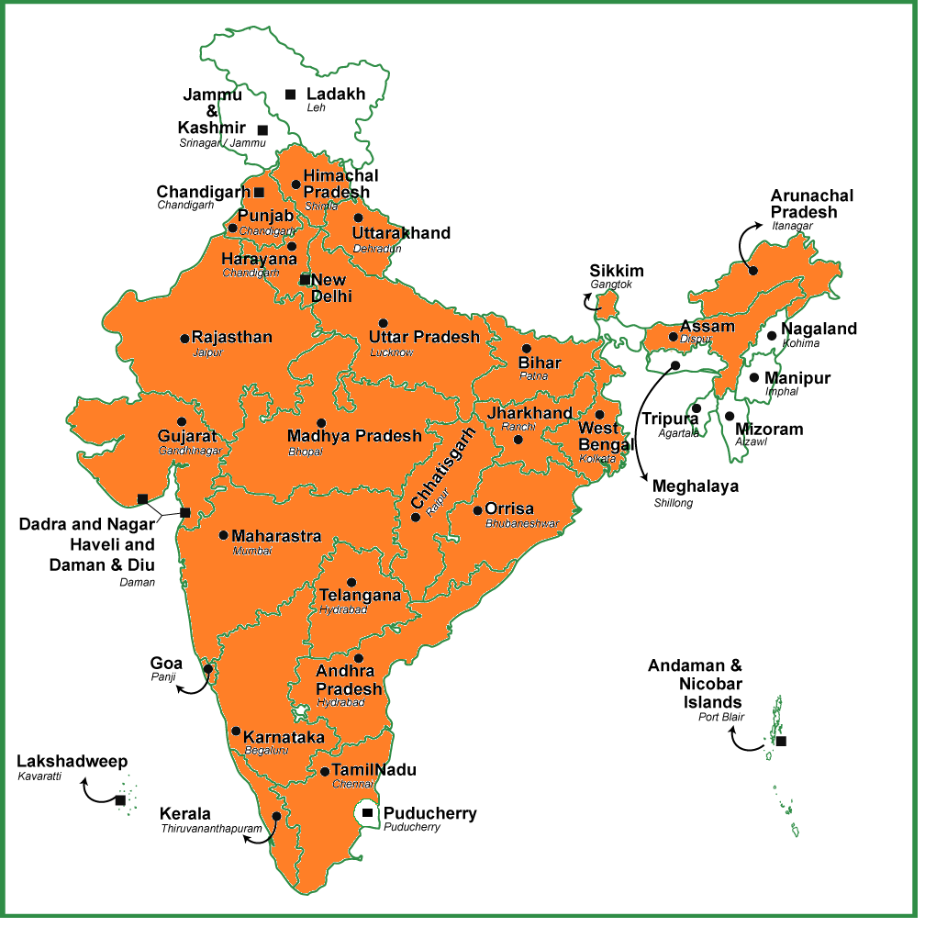

RAKSHAK PRESENCE
WORLDWIDE SERVICES
OUR PRESENCE

Slide 29
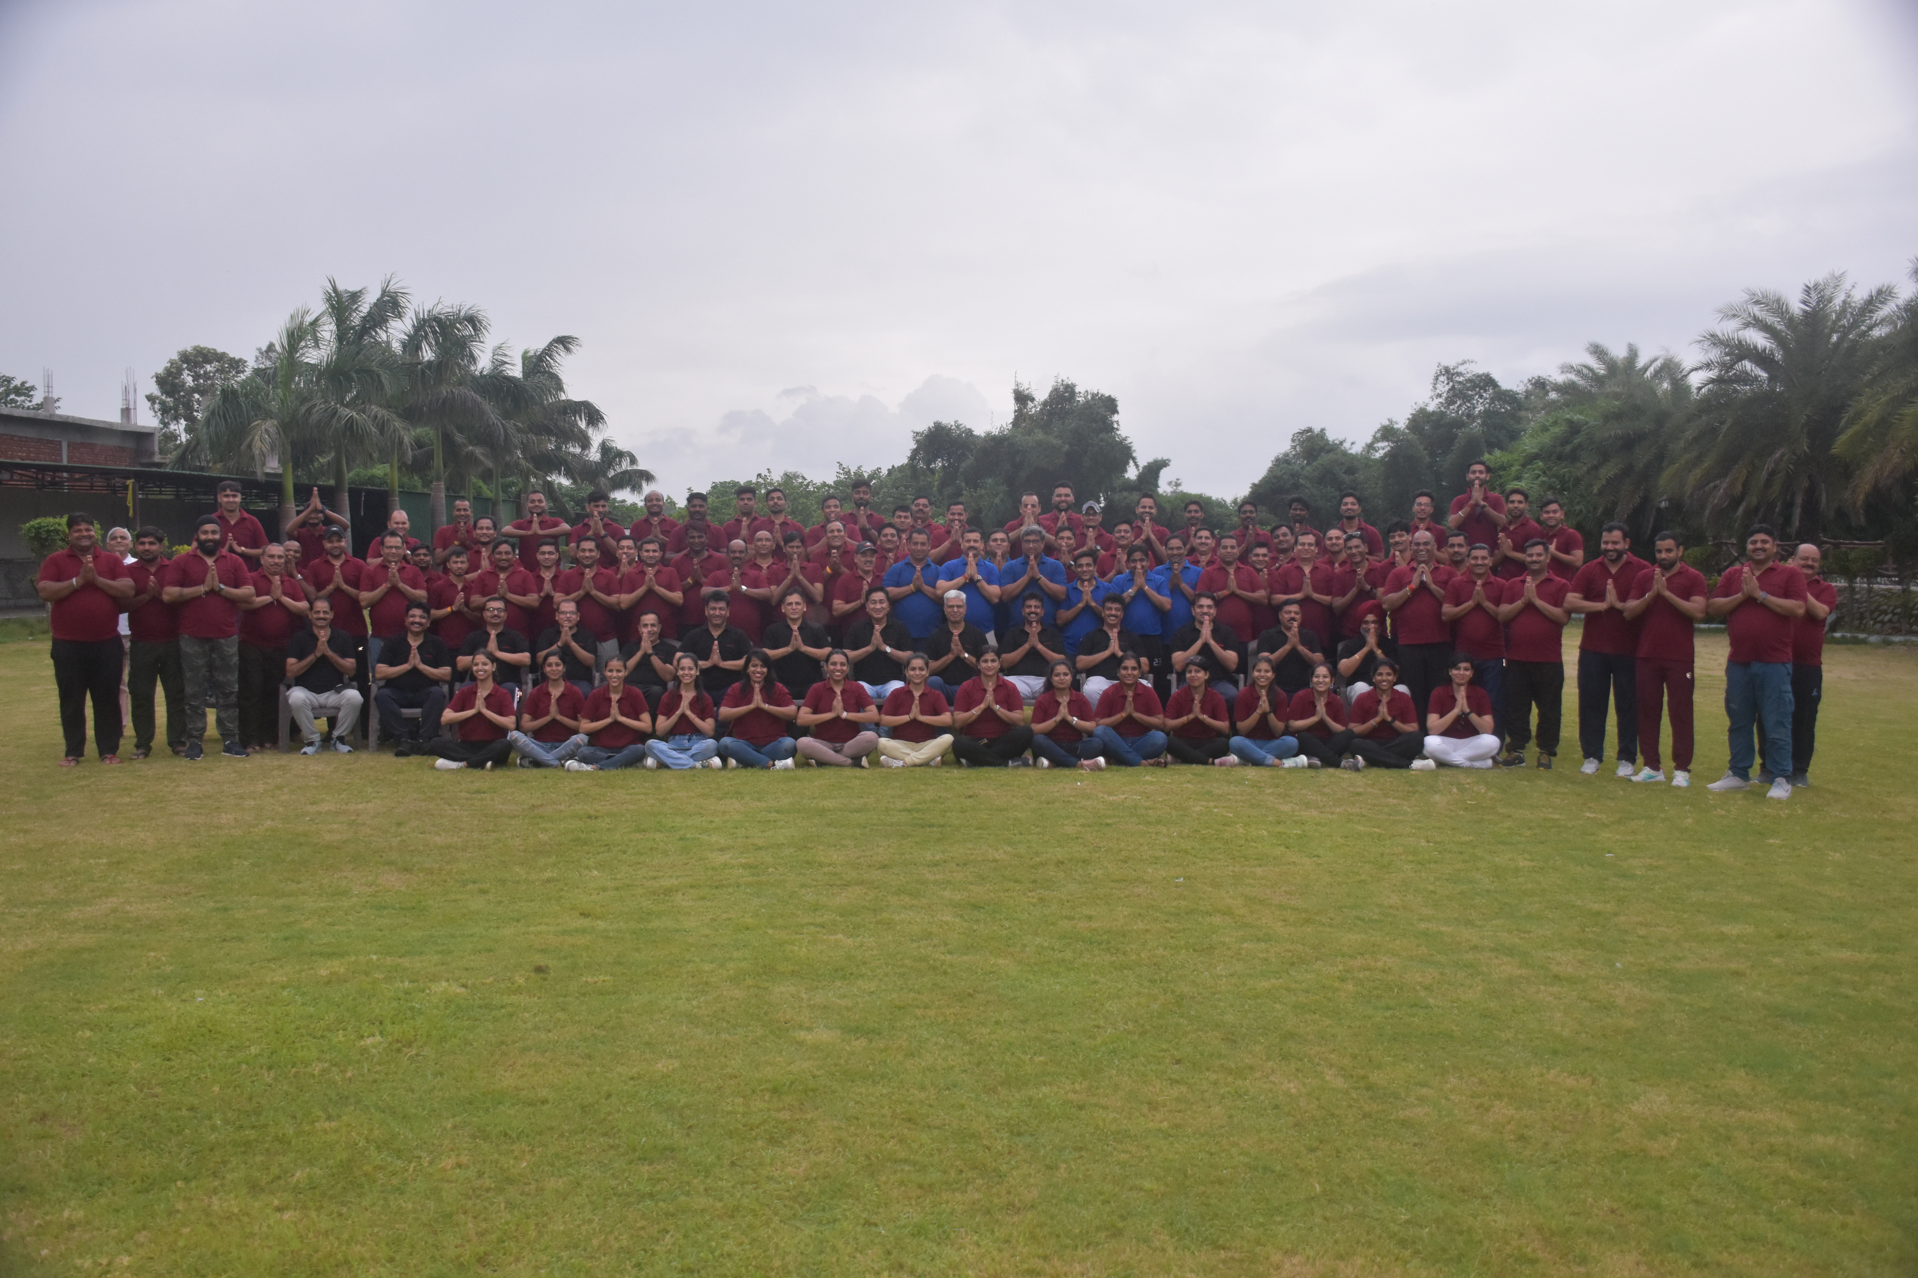



THANK YOU
CONNECT WITH US
+91 9810055834
admin@rakshaksecuritas.com
www.rakshaksecuritas.com

