Slide 1



Slide 2

RAKSHAK
SECURITAS PRIVATE LIMITED
BUSINESS PRESENTATION

Slide 3

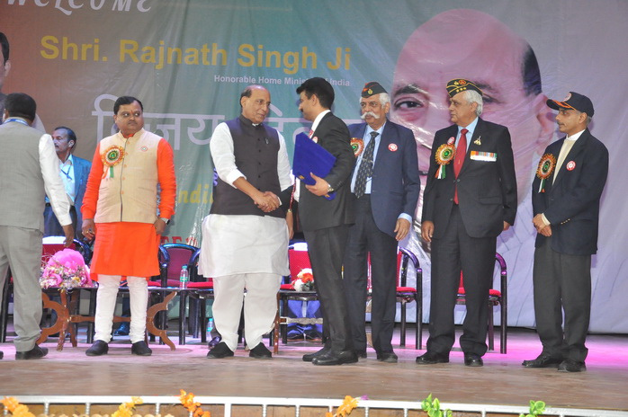
WHO
WE ARE
Rakshak Securitas Pvt Ltd is India’s leading security and comprehensive Facility Management company, career spanning 23 years
Registered under companies Act our corporate office is at Dwarka, new Delhi
Manage end to end services for corporates, industries, factories, apartments Pan India
Holding PSARA License of 18 States with a strong workforce of over 25000 and 800 esteemed clients
By developing strategic partnerships with our clients we actively contribute towards our customers’ goals and their on going upgraded requirements

Slide 4



OUR
MISSION
Creating a workforce of skilled manpower to address the Security, Manpower and Services concerns by aligning to the business requirements and making use of latest technology and gadgets
PHILOSOPHY : SELFLESSNESS EFFICACY
OUR
VISION
To deliver a world class Security and Comprehensive Facility management Service which enables our patrons to free themselves from the security and management issues and focus on to their primary business

Slide 5
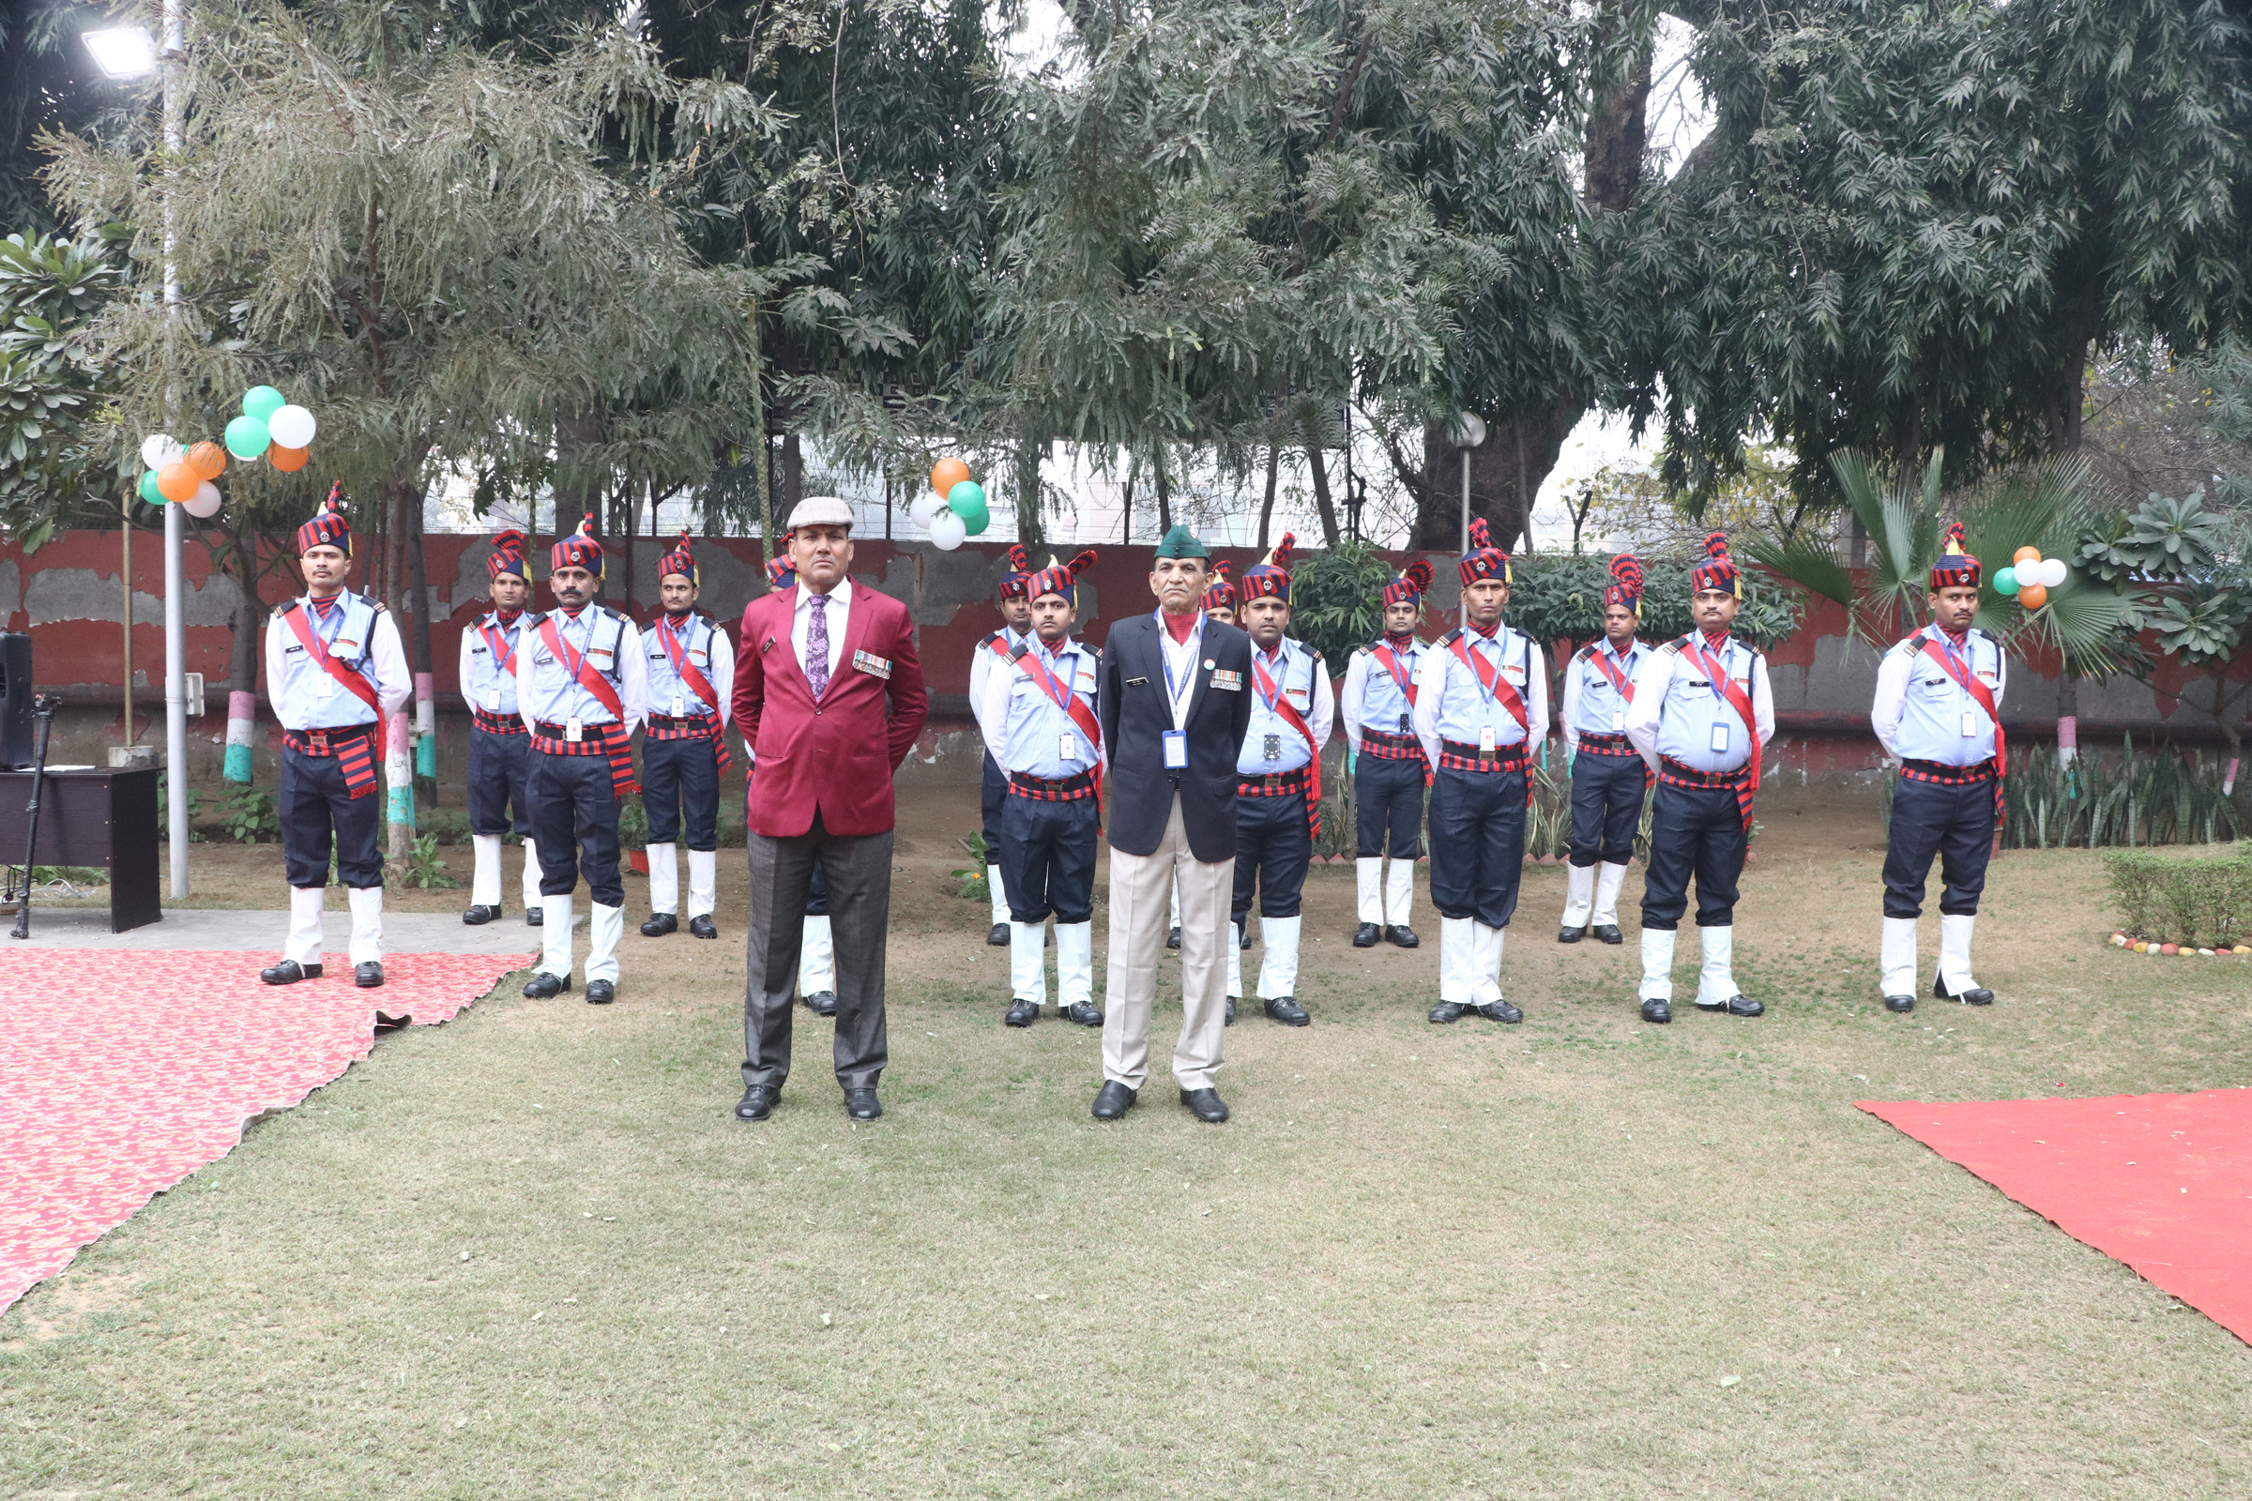



OUR
CORE VALUES
PROFESSIONALISM
INTEGRITY
RESPECT
DEDICATION
OPENNESS

Slide 6
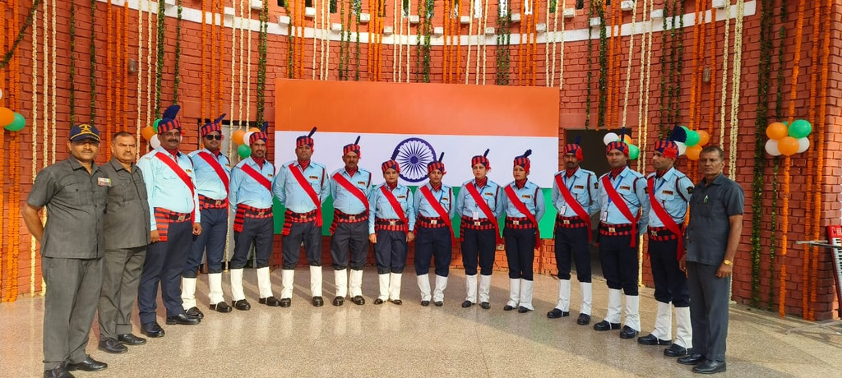
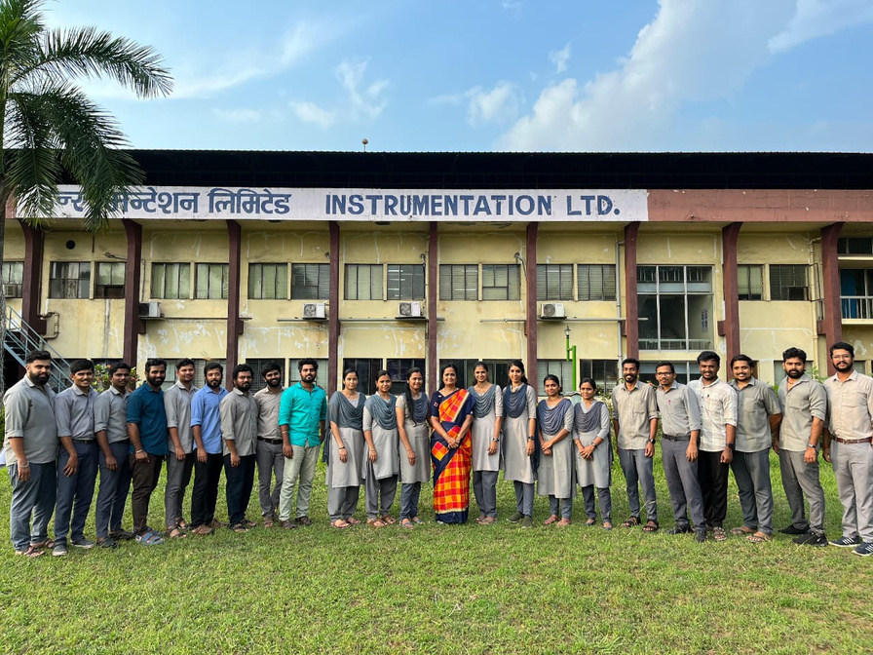
OUR
STRENGTH
  PRESENCE PAN INDIA
  PSARA LICENCES IN 18 STATES
  STRONG RECTRUITMENT AND VERIFICATION
  TRAINING AND SKILL DEVELOPMENT
  EFFICIENT REPORTING SYSTEM
  EFFICIENT RESPONSE AND MONITORING SYSTEM
  CLIENT SATISFACTION SURVEY AND QUALITY AUDIT
  EMPLOYEE WELFARE
  STATUTORY COMPLIANCES
  LEAVE AND PRIVILEGES TO ALL

Slide 7

WHY
US
WITH RIGHT TECHNIQUES IN PLACE WE CAN AIM TO REDUCE OPERATIONAL EXPENSES REMARKABLY
WE COMPLETELY AND MINUTELY ASSESS OUR CLIENTS’ REQUIREMENTS AND OBJECTIVES AND PRESENT WHAT IS SPECIFICALLY SUITED FOR THEM
WE ARE CONSCIOUS OF THE FACT THAT OUR BUSINESS GOALS HAVE TO SUPPORT AND ENRICH THE ENVIRONMENT
WE BELIEVE EVERYTHING IS POSSIBLE
UNLIKE OTHER COMPANIES WHO BELIEVE IN SUBLETTING THEIR TASKS,WE ARE A COMPANY WHO TAKE ON THE COMPLETE WORK AND EXECUTE WITH OUR OWN RESOURCES

Slide 8
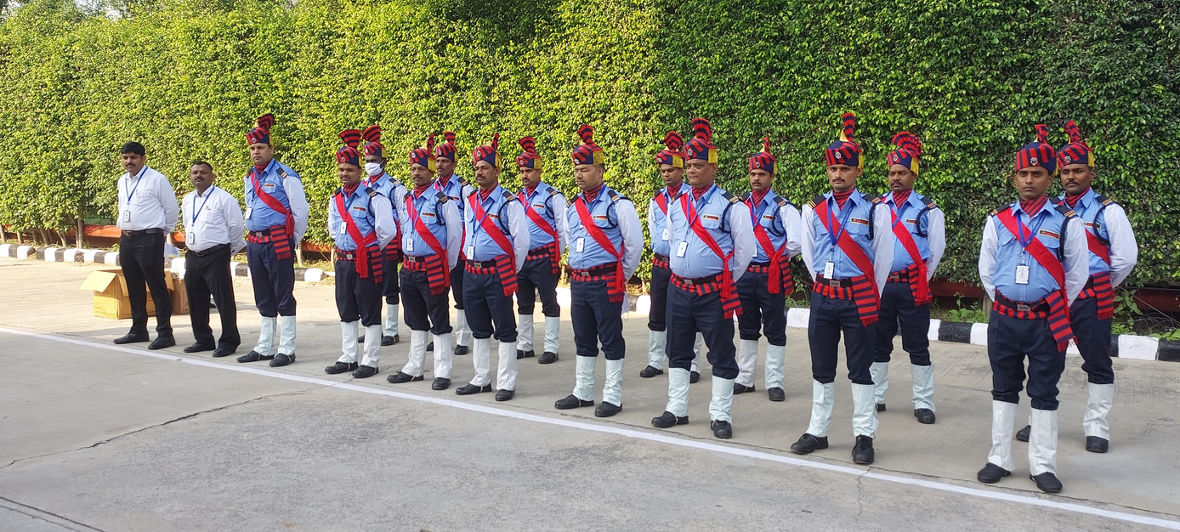
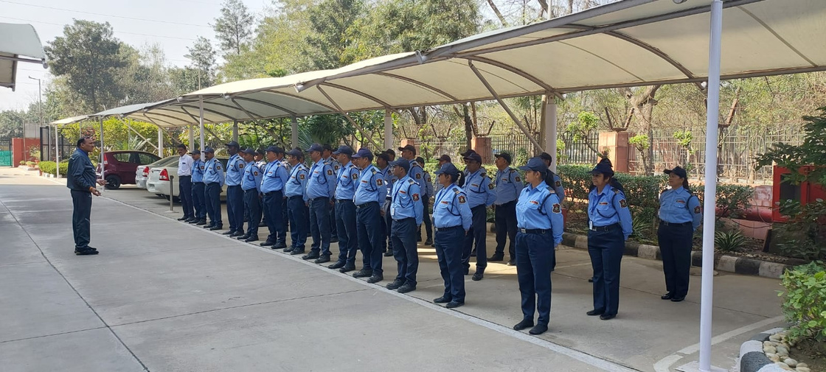
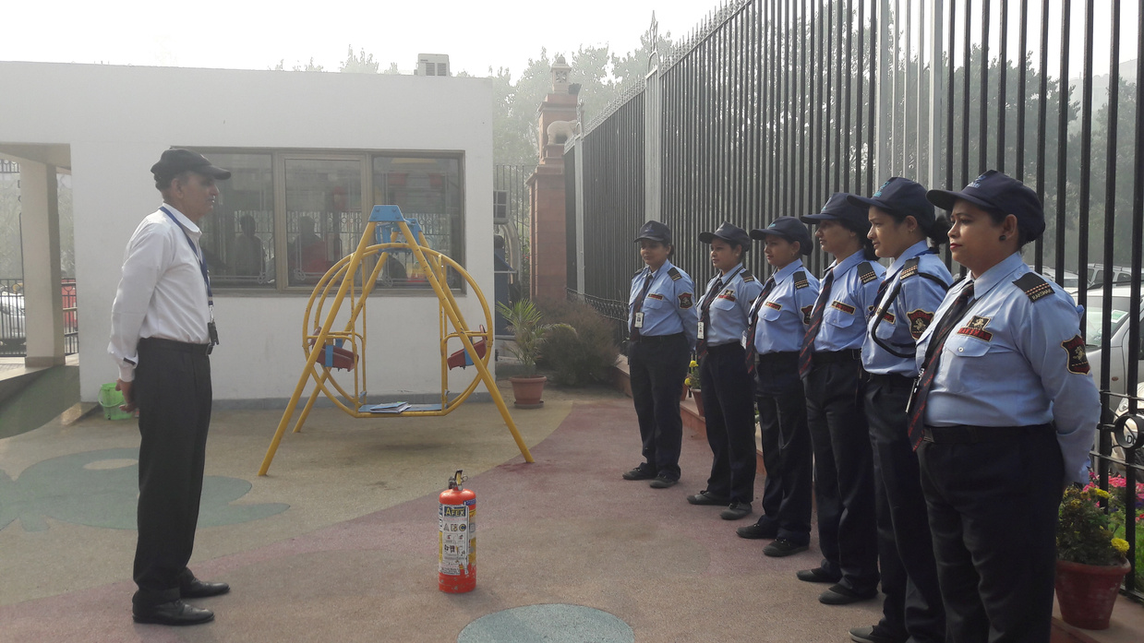
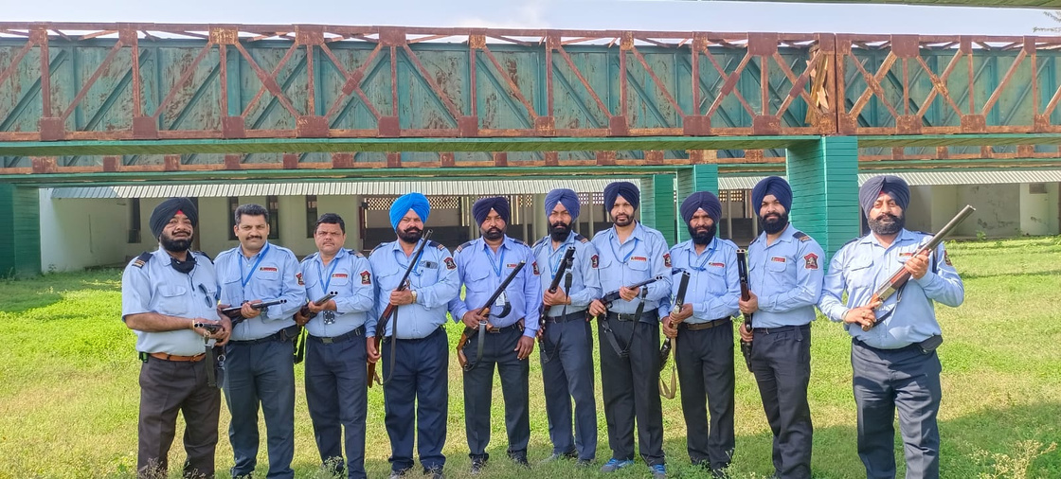
SERVICES
WE PROVIDES
SECURITY SERVICES :
  Security officers
  Security marshal
  PSO (Private Security Officers)
  Armed and unarmed security guards
  Lady security guards
  Security surveillance
  QRT (Quick Response Team)
  Event security
  Security audit

Slide 9
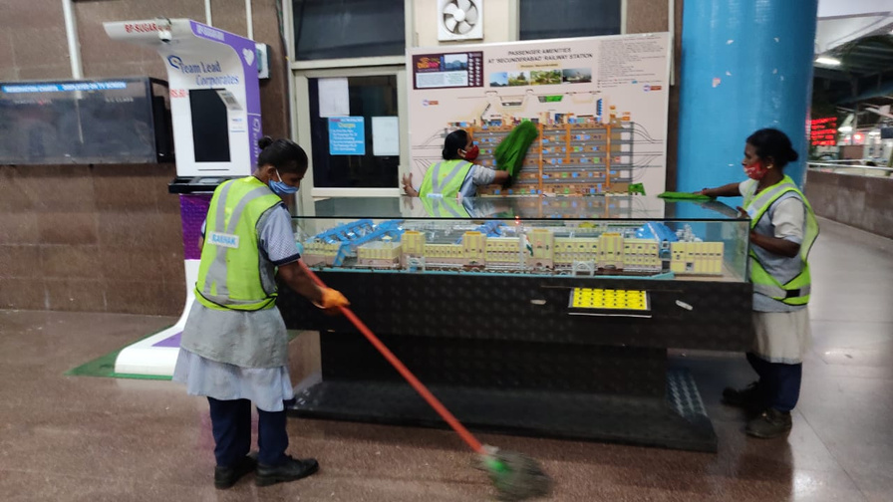
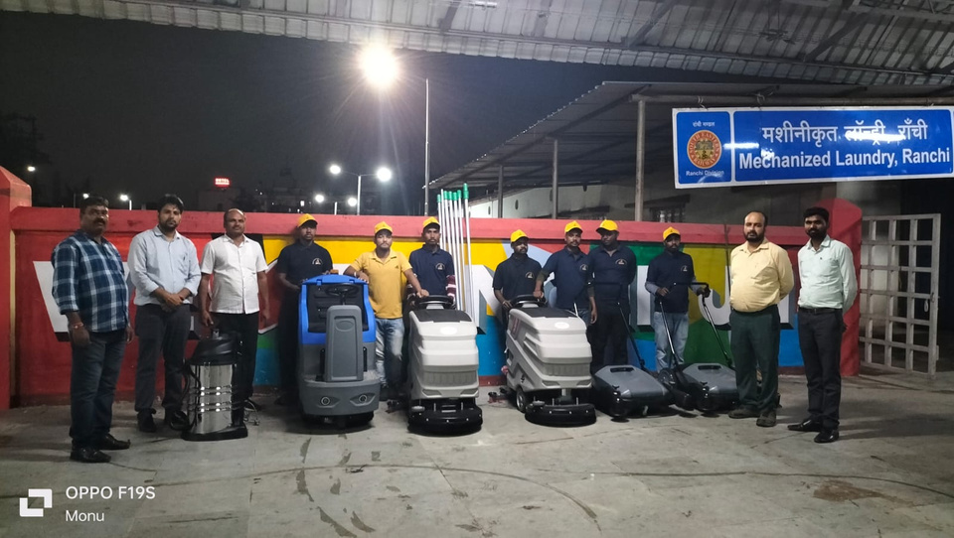
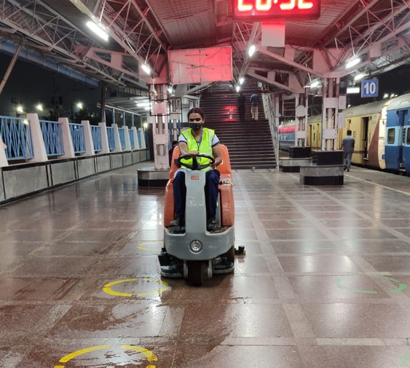
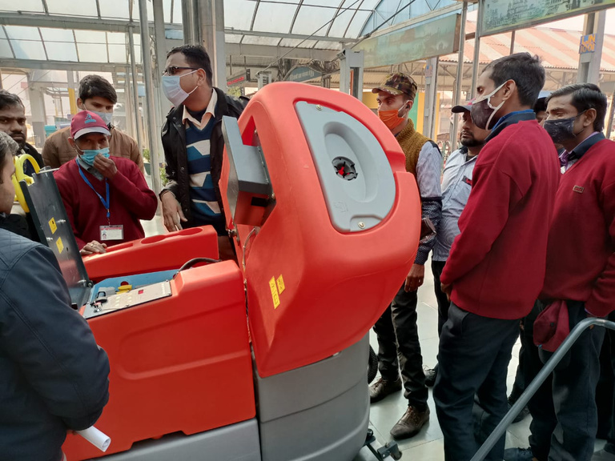
SERVICES
WE PROVIDES
HOUSEKEEPING SERVICES:
  Manual housekeeping
  Mechanized housekeeping
  Maintenance and technical services
  Horticulture and pest control
  Façade cleaning AND ALLIED SERVICES
  Conservancy staff

Slide 10
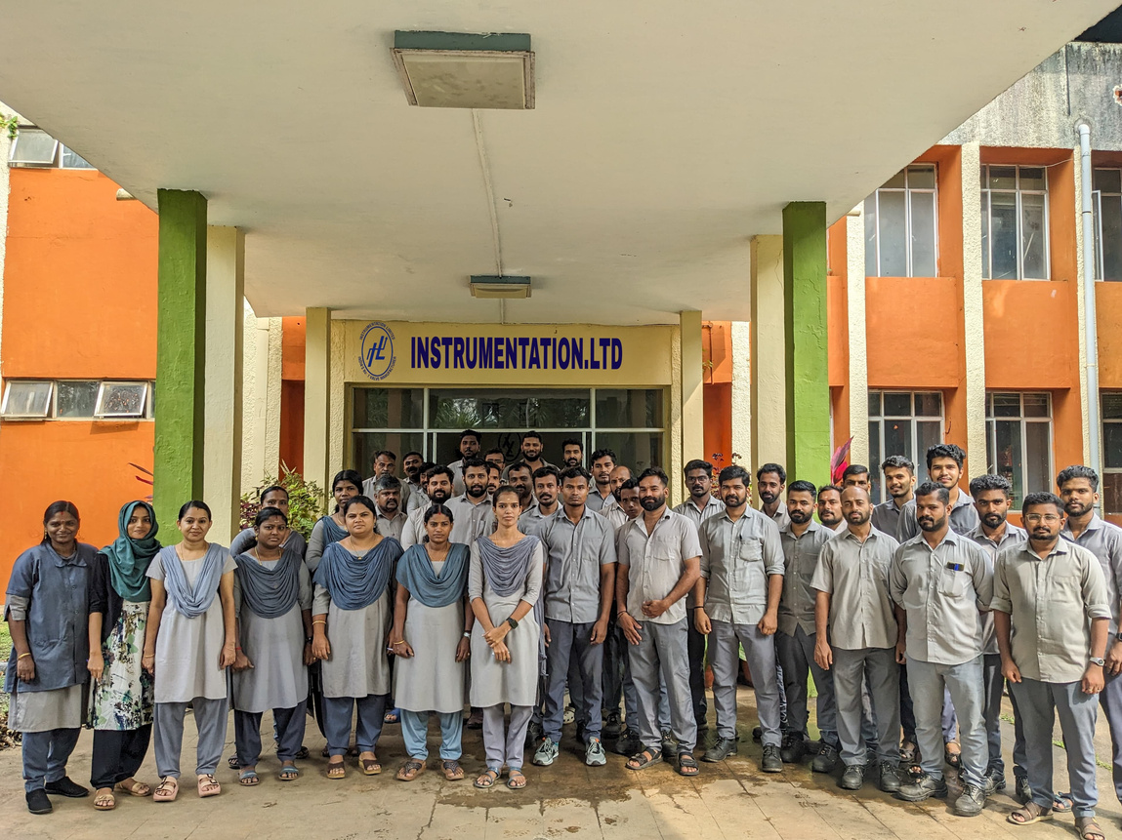
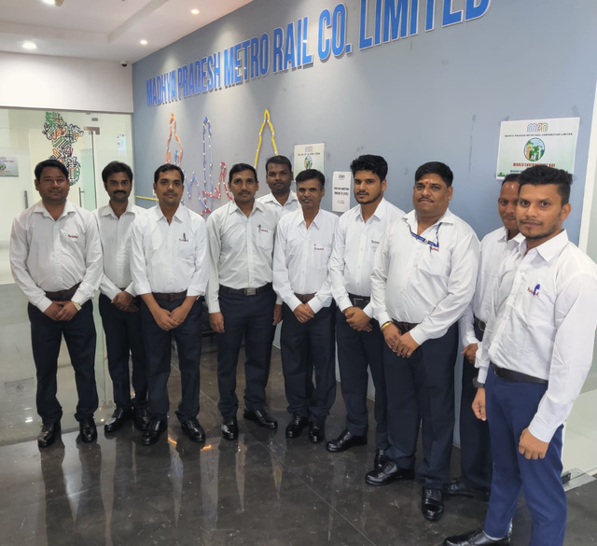

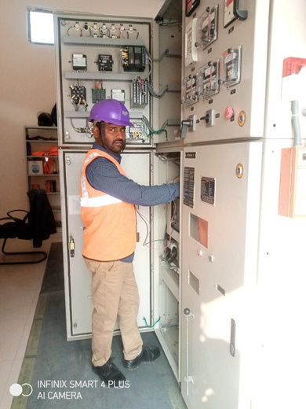
SERVICES
WE PROVIDES
MEP SERVICES :
  Mechanical services
  Electrical services
  Plumbing services
  Engineering services
MANPOWER SERVICES:
Out sourced manpower of all categories (scientists, office staff, engineering staff, technical staff, nursing staff, drivers ,room attendants

Slide 11




Honors
&
Awards

Slide 12



Pride of The Nation
BY HOME MINISTER OF INDIA, SHRI RAJNATH SINGH
to
MR. VINAY KUMAR SINGH
MANAGING DIRECTOR
RAKSHAK SECURITAS PVT LTD

Slide 13



Slide 14


Slide 15

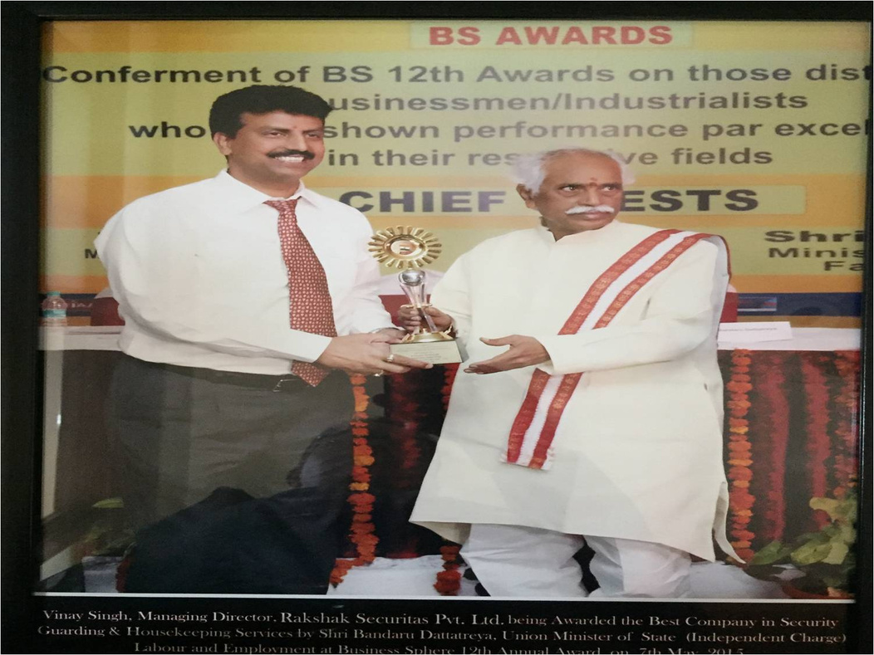
Best Industry Award
By Union State Minister of Labour & Empowerment Shri Bandaru Dattatreya
to
Mr. Viany Kumar Singh
Managing Director
RAKSHAK SECURITAS PVT LTD

Slide 16
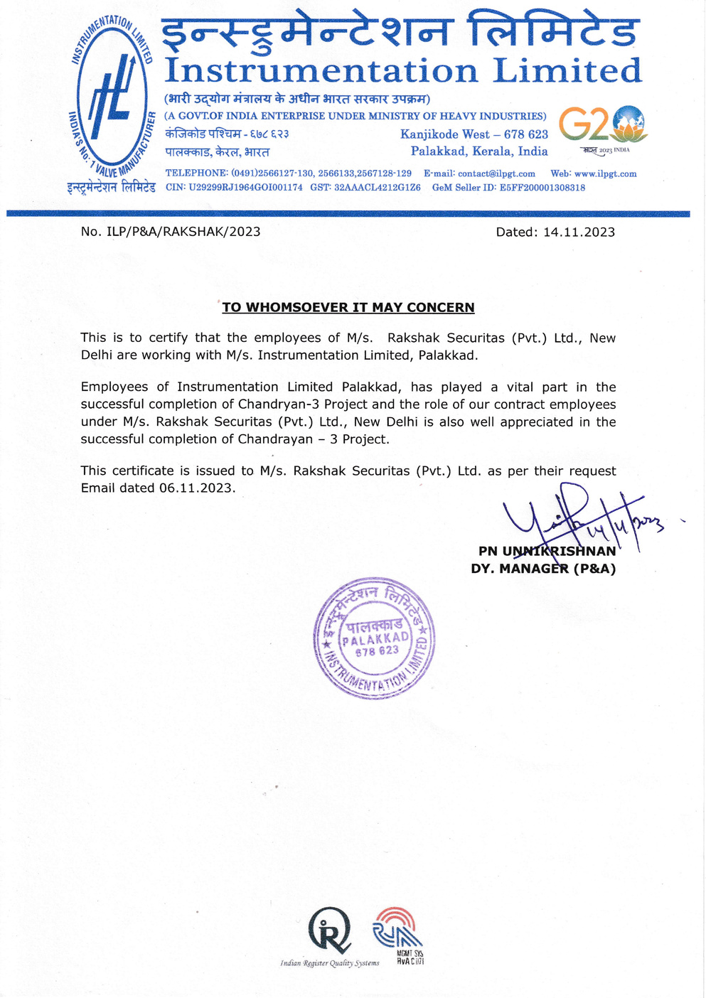
Appreciation Letter
Completion of Chandrayan - 3 Project
Employees of Instrumentation Limited Palakkad, has played a vital part in the successful completion of Chandryan-3 Project and the role of contract employees under M/s. Rakshak Securitas Pvt Ltd,
New Delhi is atso well appreciated in the successful completion of Chandrayan - 3 Project.

Slide 17

Certificate of Appreciation
Best Housekeeping Subcontractor
Tata Project HR Head Mr Rajeev Dahiya appreciated for the Housekeeping Work of Rakshak in Tata Project Corporate office in Vadodara Gujarat.
M/s. Rakshak Securitas Pvt Ltd was awarded a Certificate of Appreciation.

Slide 18
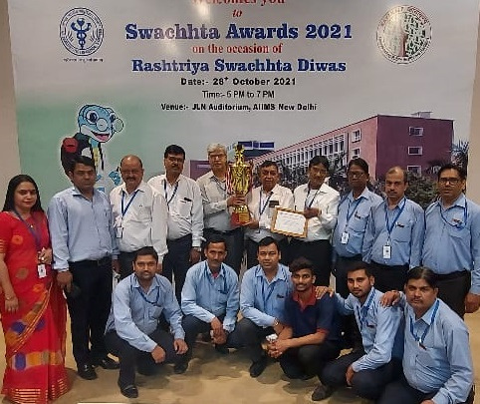
Swachhta Awards
Certificate of Appreciation
Certificate of Appreciation in recognition of contribution towards making Clean & Green AIIMS- Delhi under Kayakalp Scheme Swachhta Awards to
M/s. Rakshak Securitas Pvt Ltd

Slide 19
Some of The Golden Moments & Appreciations
  Appreciation from South Asian University & Delhi Technical University.
  Appreciation Letter by BGS International School, Dwarka, New Delhi.
  Appreciation Letter by District Judge, Dwarka.
  Rakshak’s Security Guards on Yamuna Bank published by Hindustan Times, 21 March.2018.

Slide 20


  Private Security Operations Management System (ISO 18788:2015)
  Outsourcing Product Lifecycle (ISO 37500:2014)
  Social Accountability System (SA 8000:2014)
  Facility Management System (ISO 41001:2018)
  Information Security Management System (ISO 27001:2013)
  Occupational Health & Safety Management System (ISO 45001:2018)
  Quality Management System (ISO 9001:2015)
  Environmental Management System (ISO 14001:2015)
  Commercial Establishment of Labour License
  Regional Provided Fund Certification
  Employee State Insurance Corporation Certification
  Membership Central Association of Private Security Industry

Slide 21

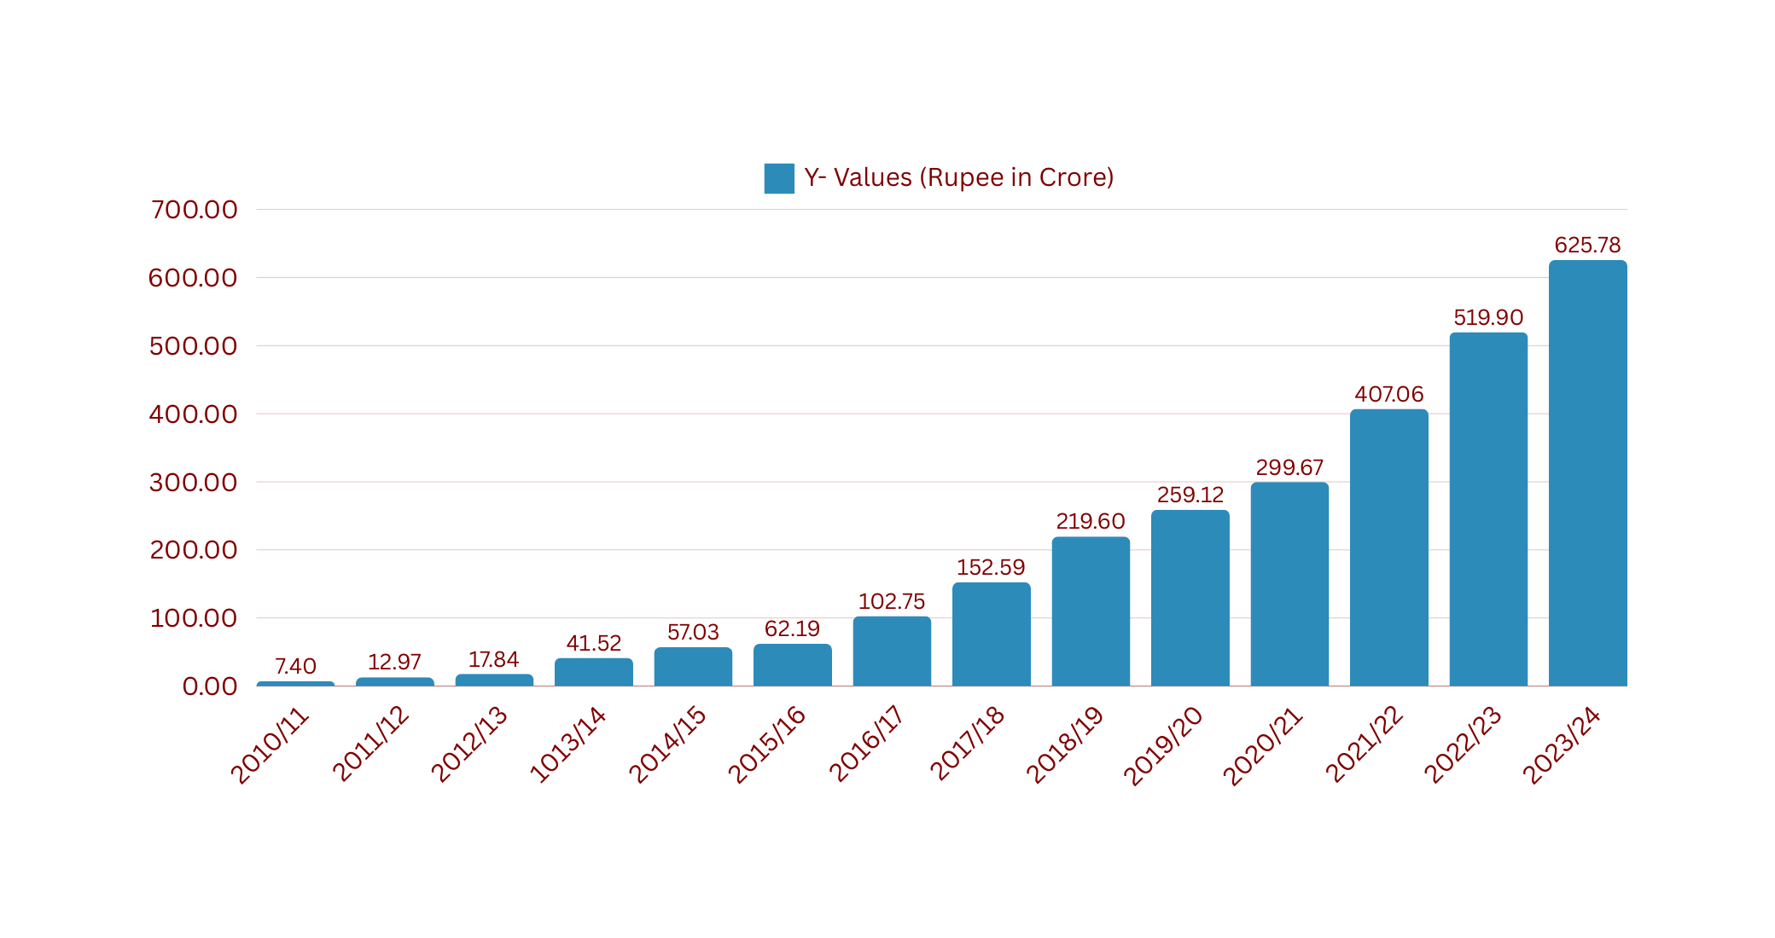
OVERVIEW
GROWTH STORY
The economic growth story of Rakshak Securitas Pvt. Ltd. showcases its transformation from a security service provider established in 2001 to a multifaceted organization offering diverse services such as facility management, manpower solutions, and housekeeping. Over two decades, the company has built a robust presence across 18 states and union territories, serving more than 500 clients, including major corporations, government entities, and private enterprises

Slide 22

OVERVIEW
MANPOWER ON ROLL
  MANAGEMENT : 24
  MANGERIAL STAFF: 142
  SUPERVISORY STAFF : 454
  STAFF : 25436
TOTAL MANPOWER: 26056

Slide 23
OUR
TARGETED SEGMENTS
Rakshak Securitas Pvt. Ltd., as a manpower service provider, targets diverse segments to cater to varying organizational and operational needs. These segments include:
Corporate Sector:
  Offices, IT parks, and corporate campuses.
  Roles like administrative staff, housekeeping personnel, and security guards are provided to ensure smooth operations and security.
Industrial Sector:
  Manufacturing plants, warehouses, and logistics hubs.
  Skilled and semi-skilled manpower, including machine operators, supervisors, and safety personnel.

Slide 24
OUR
TARGETED SEGMENTS
Rakshak Securitas Pvt. Ltd., as a manpower service provider, targets diverse segments to cater to varying organizational and operational needs. These segments include:
Residential and Commercial Properties:
  Housing societies, malls, and high-rise buildings.
  Security guards, concierge services, and maintenance personnel.
Event Management:
  Large-scale public and private events.
  Crowd controllers, ushers, and on-ground coordinators are deployed to manage safety and operations effectively.

Slide 25
OUR
TARGETED SEGMENTS
Rakshak Securitas Pvt. Ltd., as a manpower service provider, targets diverse segments to cater to varying organizational and operational needs. These segments include:
Government and Defense Projects:
  Government offices, defense establishments, and critical infrastructure projects.
  Security and operational manpower tailored to high-compliance environments.
Educational and Healthcare Institutions:
  Schools, colleges, and hospitals.
  Support staff like custodians, security personnel, and technicians to maintain safety and efficiency.

Slide 26
OUR
TARGETED SEGMENTS
Rakshak Securitas Pvt. Ltd., as a manpower service provider, targets diverse segments to cater to varying organizational and operational needs. These segments include:
Retail and Hospitality:
  Retail chains, hotels, and restaurants.
  Front-office staff, housekeeping, and inventory management teams.
Custom Solutions for Emerging Needs:
  Adaptable solutions for industries with unique manpower requirements, including tech parks and energy sectors.
  These targeted segments allow Rakshak Securitas to meet the demands of diverse industries, ensuring customized solutions that align with specific client needs

Slide 27








SOME
PRESTIGIOUS CLIENTS
EDUCATIONAL INSTITUTIONS

Slide 28









SOME
PRESTIGIOUS CLIENTS
GOVERNMENT SECTOR

Slide 29








SOME
PRESTIGIOUS CLIENTS
GOVERNMENT SECTOR

Slide 30







SOME
PRESTIGIOUS CLIENTS
MEDICAL INSTITUTIONS

Slide 31









SOME
PRESTIGIOUS CLIENTS
BANKING SECTOR

Slide 32






SOME
PRESTIGIOUS CLIENTS
CORPORATE SECTOR

Slide 33

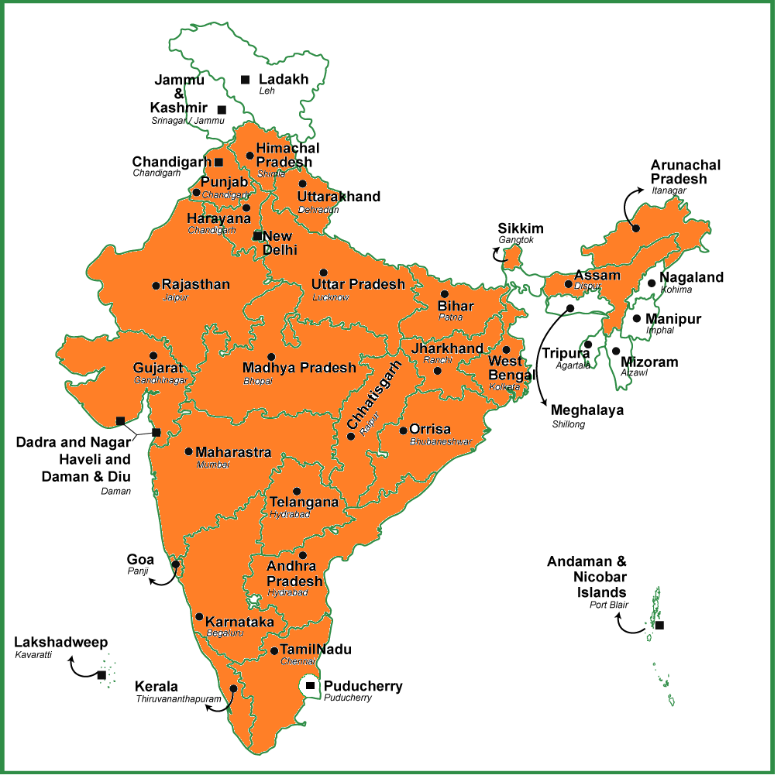

RAKSHAK PRESENCE
WORLDWIDE SERVICES
OUR PRESENCE

Slide 34
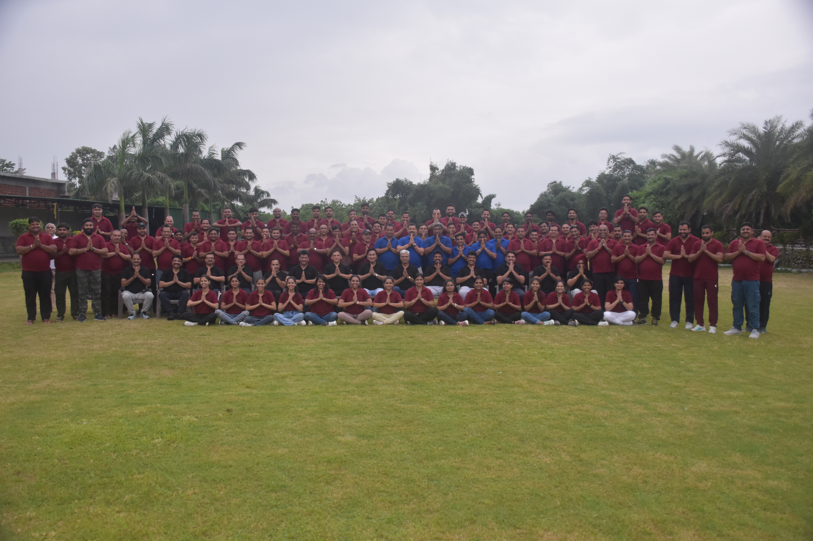



THANK YOU
CONNECT WITH US
+91 9810055834
admin@rakshaksecuritas.com
www.rakshaksecuritas.com

